Slide 1


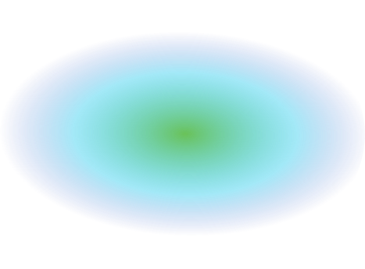
DAA Group Project
BRTS Shortest Route / Minimal Cost finder

Slide 2






Meet Our Team
MANUSHI OZA
YAGNA PATEL
MANSI PARMAR
DHAIRYA PATEL
VIRTI SHAH
S1 31
CE
21002170110083
S1 05
CE
21002170110128
S1 11
IT
21002170210056
S1 06
IT
21002170210060
S1 02
CE
21002170110208

Slide 3

Introduction
01
02
BRTS refers to Bus Rapid Transit System which a service of public transport using buses with an objective to provide faster, more efficient mode of transport to the people.
Floyd-Warshall Algo is an algorithm for finding the shortest path between all the pairs of vertices in a weighted graph . This algorithm works for both the directed and undirected weighted graphs.
2

Slide 4
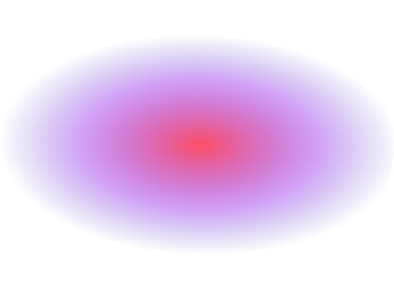
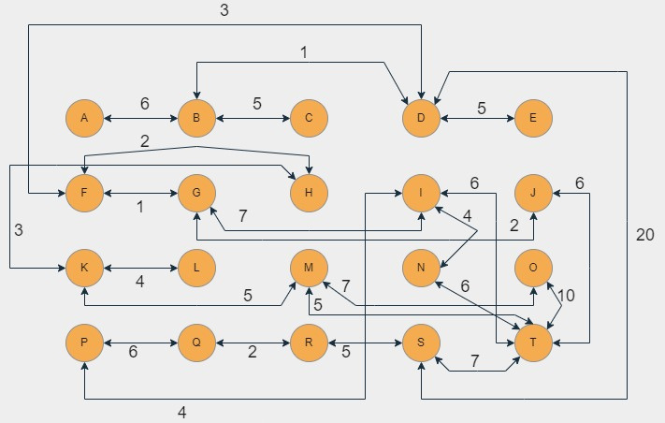
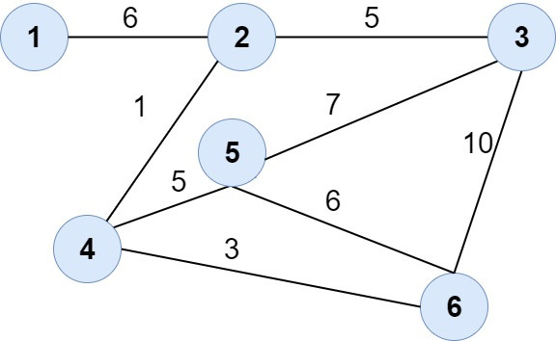
Graph
1-Ghuma Gam
2-Isckon Mandir
3-Bopal
4-Isckon Cross Road
5-Sanand Circle
6-Shivranjni
4

Slide 5


Adjacency Matrix
Adjacency
List
In order to find for an existing edge the content of matrix needs to be checked. Given two vertices say i and j matrix[i][j] can be checked in O(1) time
In order to check for an edge we need to check for vertices adjacent to given vertex.
Time complexity is O(|V|) .
7

Slide 6
Thank You!!
4

